Slide 1
Past Simple & Past Continuous

Slide 2
past simple VS past continuous
Het verschil tussen:
Taylor Swift sang last night.
Taylor Swift was singing last night.
hey girl.

Slide 3
Past Simple
NOW

Slide 4
Past Simple
WW + ED
WORK
WATCH
EXPLODE
SLEEP
ED
ED
D
ED?
SLEPT

Slide 5
Past Simple
Wanneer: Iets is in het verleden afgelopen, het is precies duidelijk wanneer het was. (door signaalwoorden) | -Yesterday, I located a yeti. -He presented the news last night. | -She went to work last weekend. -He ate a snack last night.
Signaalwoorden: yesterday, last night, last weekend, a minute ago, when I was young

Slide 6
Taylor sang beautifully last Sunday!
Tralalalalalalalalalallalaaaaaa!

Slide 8
Past Continuous
IETS WAS LANGER BEZIG IN HET VERLEDEN
NOW
(zoals zingen)

Slide 9
Jeroen is amazing at powerpooooooint! lalalalala
Taylor was singing yesterday

Slide 10
Past Continuous
WAS/ WERE + WW+ING
SHE WAS READING A BOOK.
THEY WERE PLAYING A GAME.
Je gebruikt de past continuous ook wanneer je wil vertellen dat iets bezig was en onderbroken werd door iets anders….

Slide 11
Past Continuous
WANNEER IETS IN HET VERLEDEN (LANGER) BEZIG WAS
EN
ONDERBROKEN WERD DOOR IETS ANDERS

Slide 12
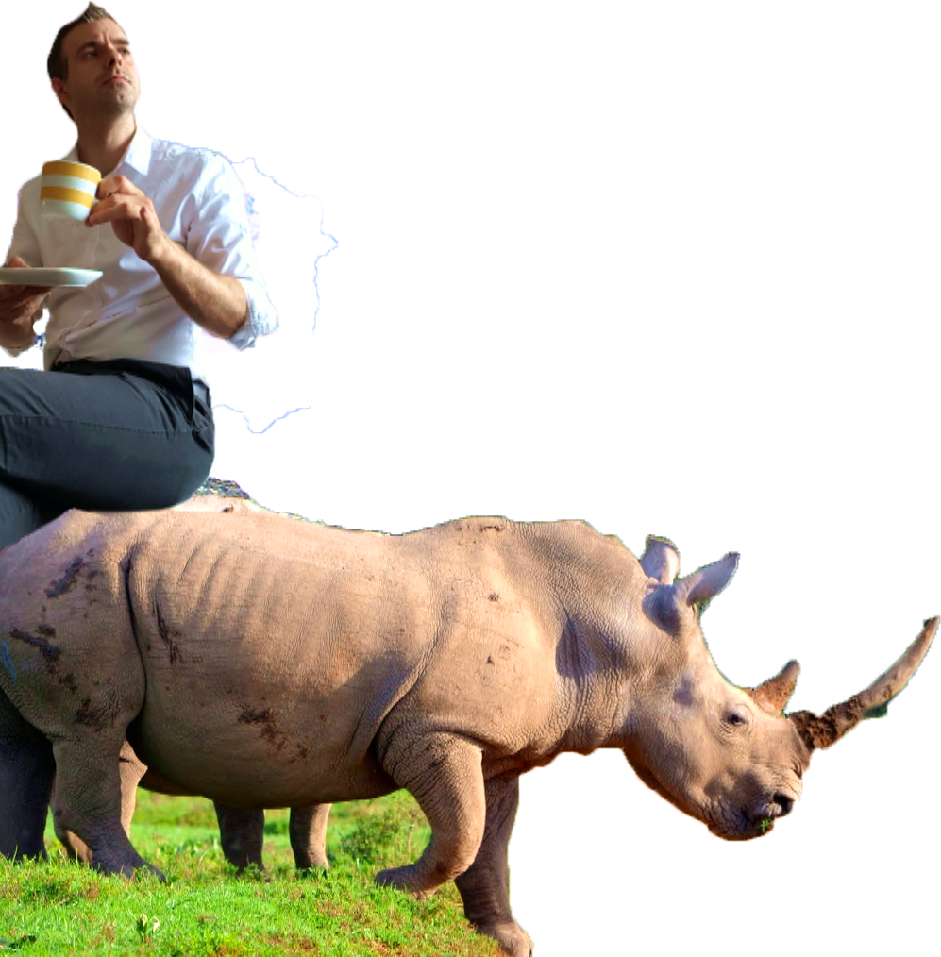
Taylor was singing when Jeroen came in
LALALALALA WTF?!
Don’t mind me and my rhino, please.

Slide 13
Past Continuous
WANNEER IETS IN HET VERLEDEN (LANGER) BEZIG WAS
I WAS READING A BOOK.
YOU WERE LAUGHING AT MY JOKE.
WE WERE SINGING A SONG.

Slide 14
WANNEER IETS IN HET VERLEDEN (LANGER) BEZIG WAS
EN
ONDERBROKEN WERD DOOR IETS ANDERS
I WAS READING A BOOK WHEN SHE CAME IN.
YOU WERE LAUGHING AT MY JOKE WHEN IT HAPPENED.
WE WERE SINGING A SONG WHEN SHE EXPLODED.
Past continuous
Past simple

Slide 15
Two actions at the same time!
I WAS READING A BOOK
WHILE HE WAS MAKING DINNER.
WHILE THEY WERE WAITING.
WERE YOU LISTENING
WHILE THEY WERE WAITING?

Slide 16
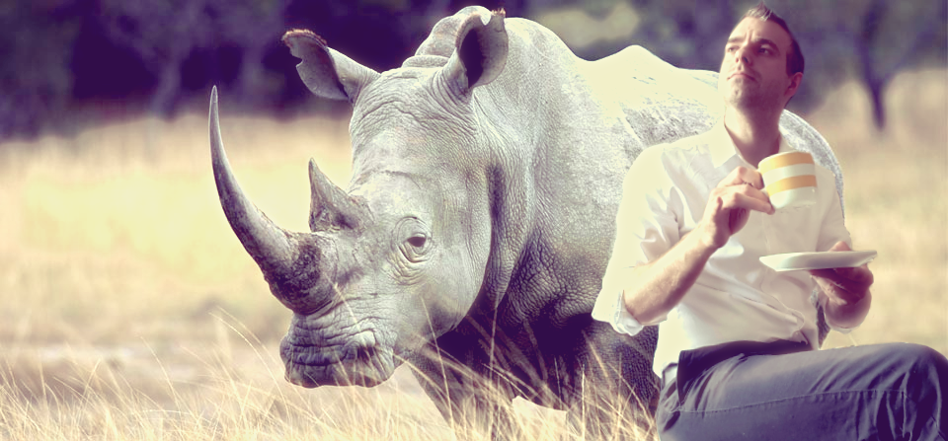
The rhino was thinking about Taytay while I was drinking my tea.

